Slide 1
Files
Chris Walshaw
Computing & Information Systems
University of Greenwich

Slide 2
Lecture Objectives
Today we will look at how to access files
opening and reading the contents
e.g. spellchecker, list files, count the length of files, search through files
create, read, update & delete (CRUD) functionality
processing CSV files
and even reading web pages
We will also touch on some very important concepts
exception handling
recursion

Slide 3
Motivation
Many programs need to access files
However file access has extra complications
does the file exist
is the file readable
is the file encrypted
and once it is open
has the file been updated externally
has the file been deleted externally
These are complications because they are beyond our control as programmers
for the most part we can put in preventative measures (validation) to check that the user input is as requested
but there is little to stop the user deleting or updating a file, even if it was correct initially
In this lecture we will look at file handling in Python
including how to warn the user (nicely) when a file isn’t accessible

Slide 4
File handling
The key function for working with files in Python is open()
The open() function takes two parameters – filename and (optionally) mode
There are four different modes for opening a file:
“r” – read (default)
“a” – append
“w” – write
“x” – append
So the following lines are equivalent to open a file for reading
file = open("filename.txt")
file = open("filename.txt", "r")
https://www.w3schools.com/python/python_file_handling.asp

Slide 5
Reading a file
Once a file is opened we can use the .read() method to read the contents as a string
contents = file.read()
And to split it into a list words, use the string .split() method
words = contents.split()
https://www.w3schools.com/python/python_file_open.asp

Slide 6
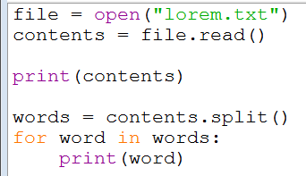
01File_reader
Example 1 demonstrates these techniques
reads & prints a file as a string and a list of words
print the contents as a string
split the contents into a list of words and print each one

Slide 7
Working with the file system
Another complication of opening files is that it access the computer file system
This means it uses low-level file access resources which must be released when the program finishes
even if something has gone wrong when opening the file
If not, eventually the computer will run out of resources and may stop functioning

Slide 8
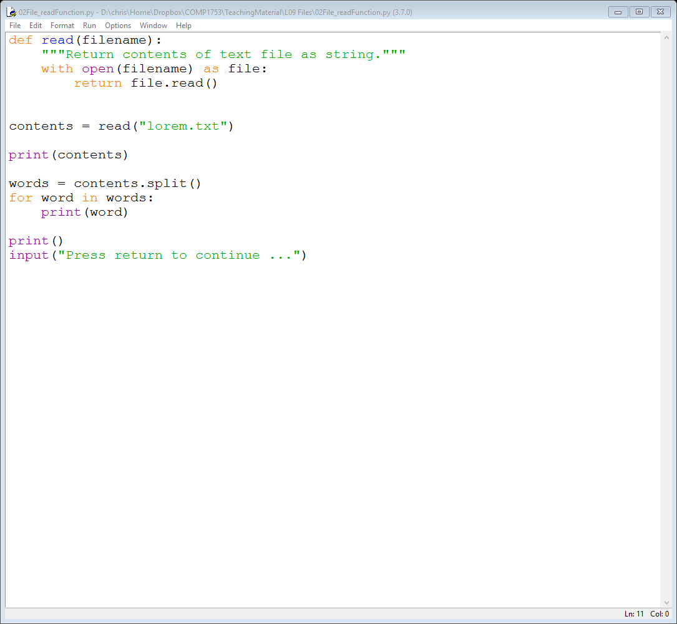
Using with
Python has an elegant way of doing this using the with keyword
this will ensure that all the resources are closed / cleaned up when the program finishes, even if something has gone wrong
Opening and reading a file is such a common operation, we put it all in a function

Slide 9
02File_readFunction
Example 2 demonstrates this

Slide 10
Spell checker
Now that we can read in text files we can easily create a basic spell checker
This weeks download contains dictionary.txt, a list of ~44,000 lower-case words
So we can read in the file and run a loop which repeatedly prompts the user for a word
if the word is in the list, we assume it is spelt correctly
if the word is not in the list, we assume it is a misspelling
if the user enters nothing, the loop terminates

Slide 11
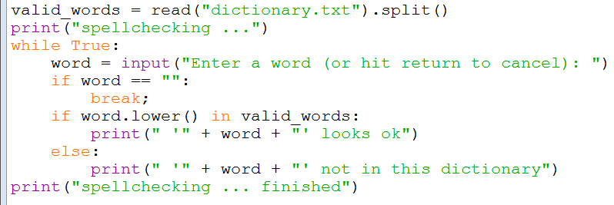
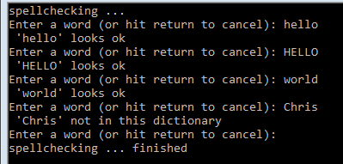
03Spellchecker_initial
Example 03 demonstrates this

Slide 12
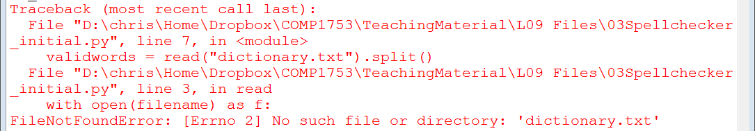
Exceptions
What if the user has deleted or renamed the dictionary.txt file?
The read() function will ensure that all the resources are released, but the user will still get a complicated and unhelpful Traceback
This is known as an exception

Slide 13
Exception handling
Exceptions can arise when something unexpected goes wrong, e.g.
a file not accessible
a web page not available
the computer / tablet / phone runs out of memory
Python, and most other languages, have a way of handling exceptions
Essentially we wrap the code we want to use between try and except statements
If something goes wrong the execution jumps to the except statement
then we can give the user a more concise / helpful error message
https://www.w3schools.com/python/python_try_except.asp

Slide 14
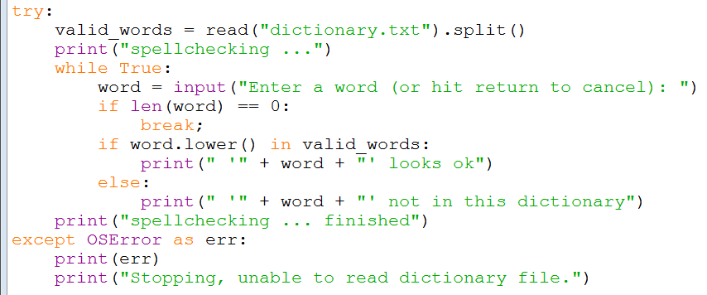
04Spellchecker_tryExcept
Example 4 demonstrates try … except
the code between try and except is identical to example 3 (but indented)

Slide 15
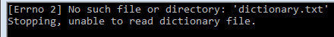
try … except notes
You can do whatever you like in the except block; for example, you could
print out an error message (here we have printed out two, the Python error message and our own)
prompt the user for another file name
do nothing and end the program silently!
However, you should do your best to keep the user informed and the program running
You do not need to know how to use try … except for the exam
but you should be aware of the concept

Slide 16
Accessing the file system
So far we have only opened files in the current folder
i.e. the folder in which the .py file is located
To get wider access to the file system we can import the os (operating system) module
Terminology: in os (like UNIX)
folders are referred to as directories
directory often shortened to dir
the address of a file is referred to as a path
e.g. C:\Users\chris\Documents is a typical path to my documents folder on a PC

Slide 17
Using os
Some useful os attributes are
os.curdir – the current directory
os.pardir – the parent directory (the directory that contains the current directory)
Some useful os methods are
os.listdir(dirname) – returns a list of files in dirname
os.path.isdir(path) – returns True if path refers to a directory
e.g. C:\Users\chris\Documents would return True but C:\Users\chris\Documents\lorem.txt would return False

Slide 18
Recursion
In order to drill down into the file system we create an index() function that does something like
def index(dirname):
filenames = os.listdir(dirname)
for filename in filenames:
path = dirname + "\\" + filename
if os.path.isdir(path):
index (path)
So the index() function calls itself
This is known as recursion
list all the files in the directory
loop over the files
construct a path for each file
if the file is actually a directory, then index it

Slide 19
Example – list all files
Using os and recursion we can list all in a directory and all of its sub-directories
It allows the user to input their choice of directory which can either be
the current directory (if nothing is input)
the parent directory (if “..” is input)
any other directory (if the full path is input)
e.g. “C:\Users\chris\Documents”

Slide 20
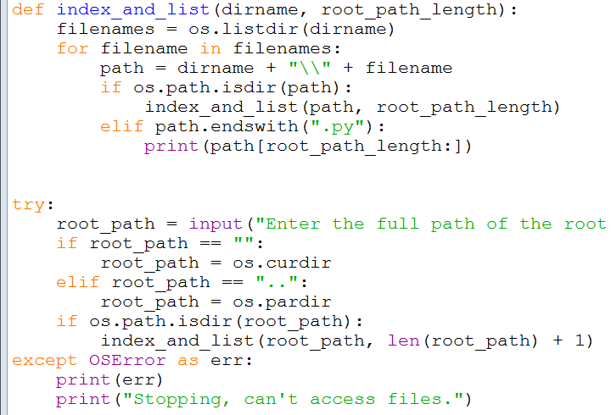
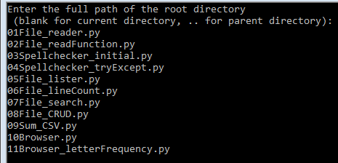
05File_lister
Example 5 demonstrates this

Slide 21
05File_lister – notes
Example 5 only lists Python (.py) files
but easy to change this (get rid of the elif: line and change to else:)
The main program passes in the length of the path for the root (starting) directory
this is so that the root directory can be trimmed off when the file name is printed out
e.g. would print out “L01 Introduction\01HelloWorld.py” rather than “C:\Users\chris\Documents\COMP1753\L01 Introduction\01HelloWorld.py”

Slide 22
Recursion and exceptions
Also notice that we only need one try … except block (at the top level)
If an exception occurs, the execution of the code will always jump to the except statement
even if the execution has recursed several times into the index_and_list() function!
So exceptions are really powerful ways of handling all kinds of problems, with minimal code

Slide 23
More examples
Of course just listing files is a bit dull
We could also open each file and do some processing of the text inside
For example:
count the number of lines in the file
do a text analysis of a file (character count, word count, word frequency, …)
search for a word in all relevant files
…
We shall do 1. and 3.

Slide 24
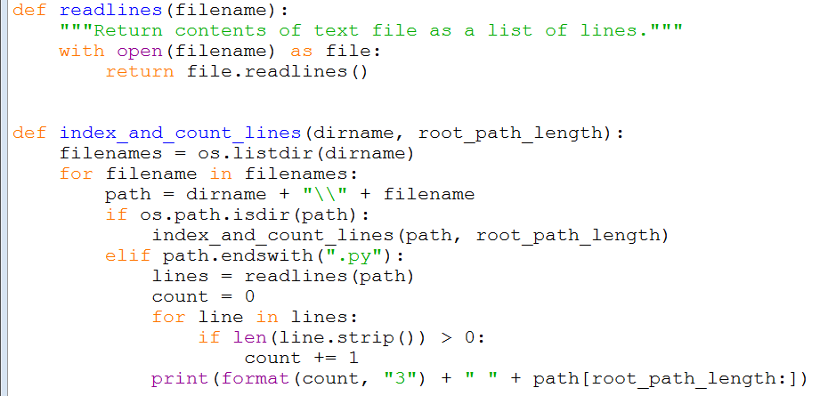
06File_lineCount
Example 6 demonstrates how to count the number of lines in all Python files
a new variant of the read() function
only open Python files
don’t count blank lines

Slide 25
06File_lineCount – notes
Example 6 uses a new function called readlines() to read the file
this returns the lines of the file in a list
essentially equivalent to reading the file as a string and splitting it at each newline character into a list
It only counts non empty lines to try to measure how much code is in each file
could extend this further by stripping out any comments too

Slide 26
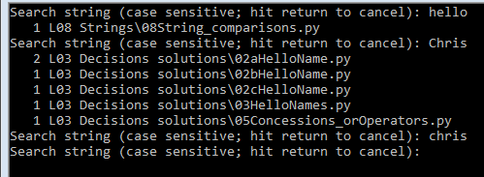
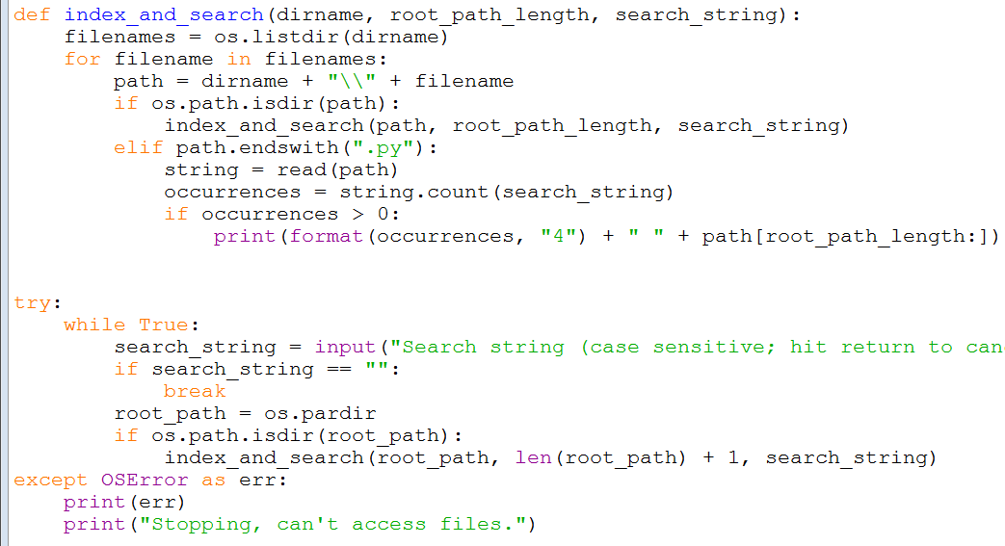
07File_search
Example 7 demonstrates a simple text search
prints the number of occurrences of the search string

Slide 27
CRUD functionality
So far we have just read files, but Python file-handling has so-called CRUD functionality via open(filename, mode) and os
Create – use open() in “x” mode to create an empty file, or “w” (write) mode to create and write a file
Read – use open() in “r” mode (default)
Update – use open() in “w” (write) mode to overwrite a file, or “a” (append) mode to add to it
Delete – use os.remove(filename)
NB in general you can only easily modify text-based files (e.g. .txt, .py, .csv, …)
for binary formats (.docx, .xlsx, .pptx, .pdf, …) you need more specialised techniques
https://www.w3schools.com/python/python_file_write.asp
https://www.w3schools.com/python/python_file_remove.asp

Slide 28
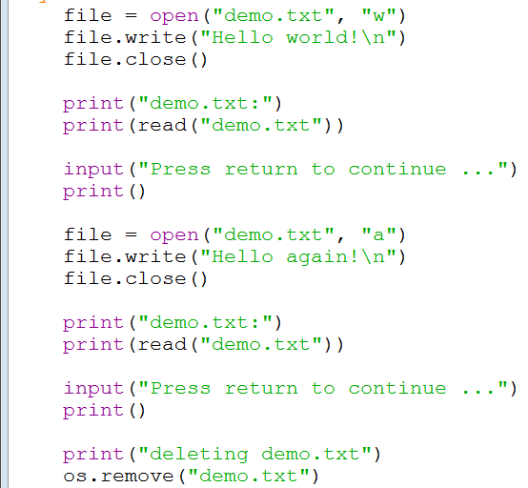
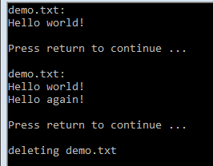
08File_CRUD
Example 8 demonstrates this
the file is created & written to, appended to and then deleted
the file needs to be closed after each operation
the contents are printed after each operation to check the contents

Slide 29
Processing CSV files
As you probably know CSV files are a text-based form of spreadsheet
CSV stands for comma separate values
We can easily read and process them, e.g.
look up a value
add up a column of figures
insert new data

Slide 30
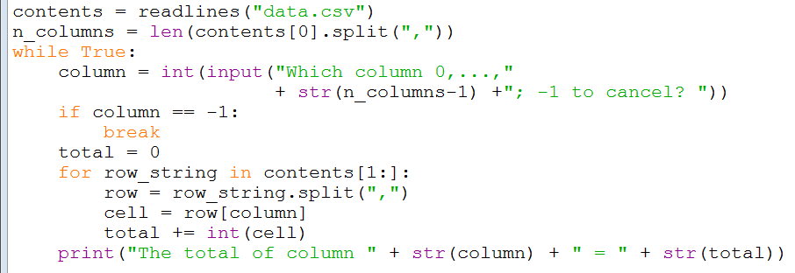
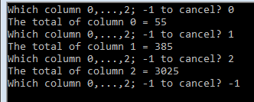
09Sum_CSV
Example 9 adds up columns of figures from a CSV file
the user chooses which column
it is assumed that the first row contains headers

Slide 31
Web page processing
Our final examples demonstrate how easy it is to read web pages
A web page is just a text-based file (HTML) which is served from the internet
rather than the local file system
Of course, HTML code is full of mark-up, CSS and JavaScript code
not so easy to read as a text file!
It is possible to use external libraries to extract the content from the HTML (ignoring mark-up, etc)
but we do not have time to pursue this here

Slide 32
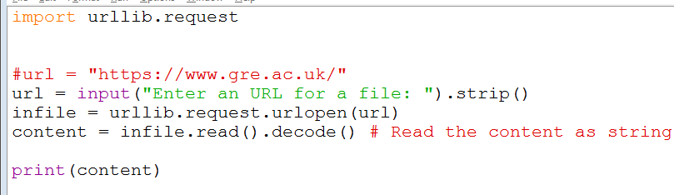
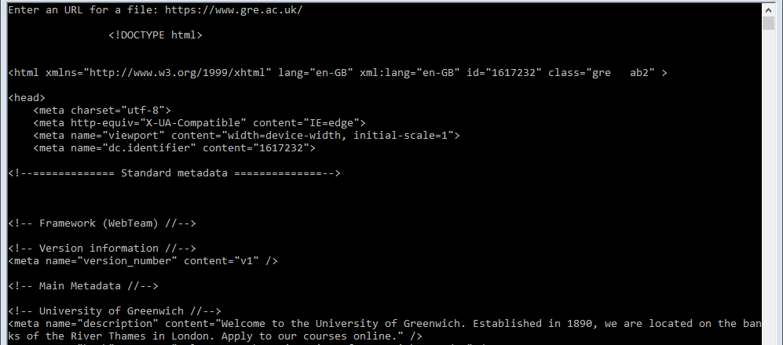
10Browser
Example 10 just reads and prints out a webpage
the user chooses which one

Slide 33
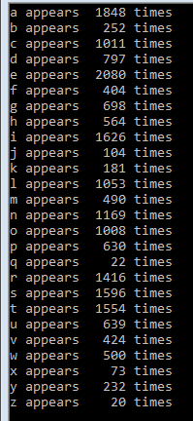
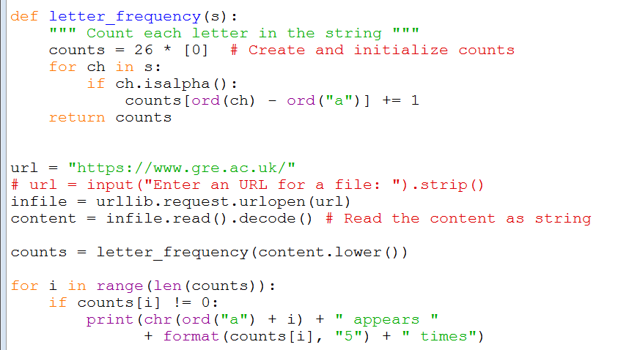
11Browser_letterFrequency
Example 11 does a frequency count of the letters

Slide 34
11Browser_letterFrequency – notes
The letter_frequency() function is different to the frequency() function from last week
arguably simpler
It just creates a list of 26 items, one for each letter and initialises each item to 0
As it processes the page, it figures out the index of each letter using the ord() function
ord() returns the Unicode code point of the letter
so a has index 0, b has index 1, c has index 2, etc

Slide 35
Summary
Today we looked at how to access files
opening and reading the contents
e.g. spellchecker, list files, count the length of files, search through files
create, read, update & delete (CRUD) functionality
processing CSV files
and even reading web pages
We also touched on some very important concepts
exception handling
recursion

